Slide 1
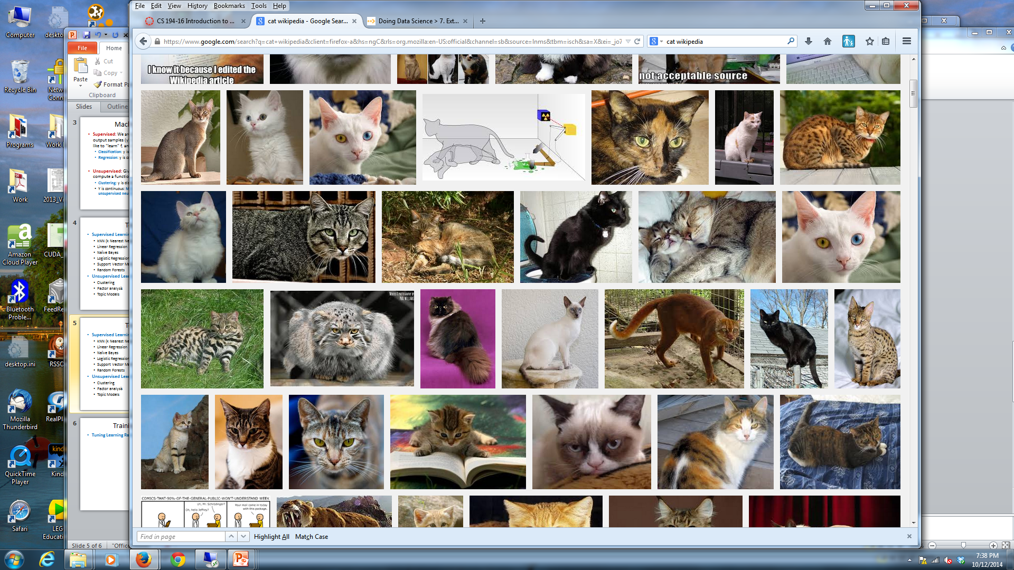
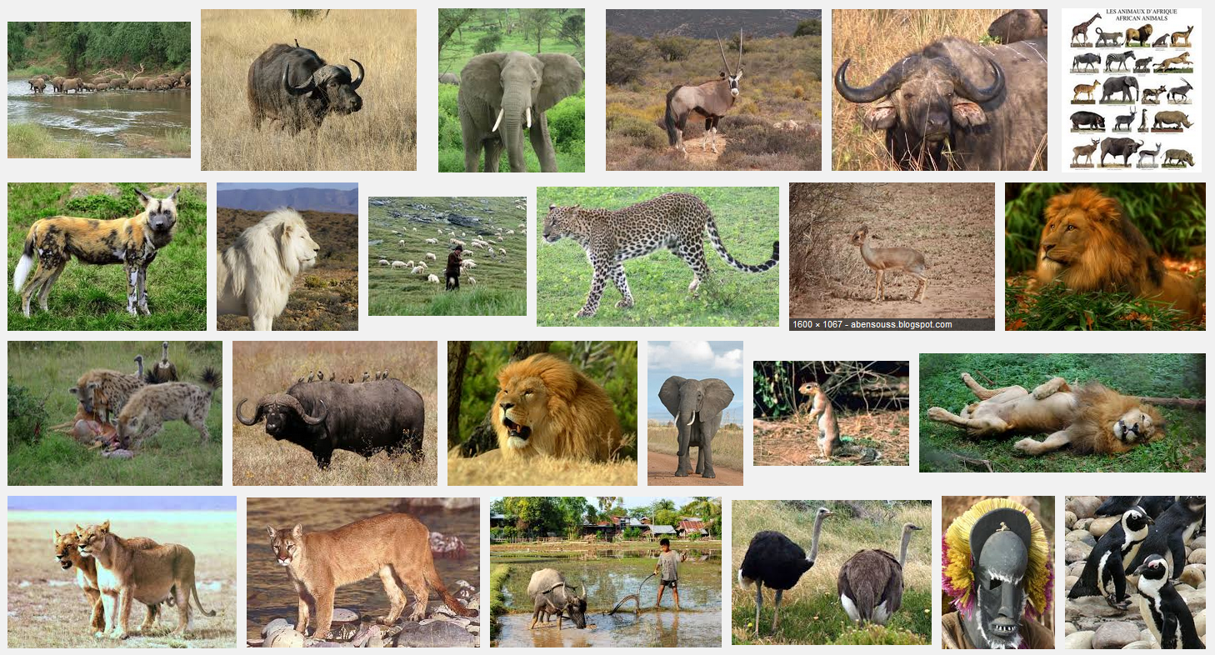
k-Nearest Neighbors
Given a query item: Find k closest matches in a labeled dataset ↓

Slide 2
k-Nearest Neighbors
Given a query item: Return the most Find k closest matches Frequent label

Slide 3
k-Nearest Neighbors
k = 3 votes for “cat”

Slide 4
k-Nearest Neighbors
2 votes for cat,
1 each for Buffalo, Cat wins…
Deer, Lion

